Slide 1




CORPORATE
PROFILE
GENERAL PROMOTION
FIELDS OF ACTIVITY
PRODUCTION TECHNOLOGY
STAFF
R&D DEPARTMENT
OVERVIEW OF SECTORS
QUALITY
REFERENCES
01.02.2019

Slide 2


COMPANY OVERVIEW
DUAYEN YAPI A.Ş. is the market leader in developing and manufacturing high-end
quality adhesive, coating and insulation products in Turkey.
We provide an excellency in serving construction market through the most
advanced research and development solutions,
combined with superior product design and highly professional and experienced staff.

Slide 3
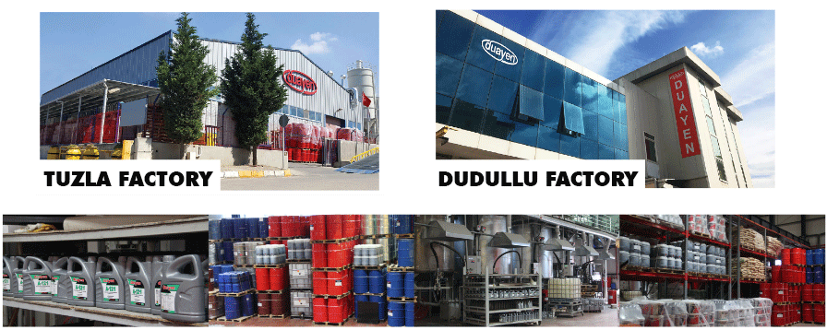
COMPANY OVERVIEW
The company was established in 2001 to serve the construction sector and
continues its activities within a closed production area of 7500 m2 in Istanbul
with a production capacity of 600 thousand tons / year.

Slide 4
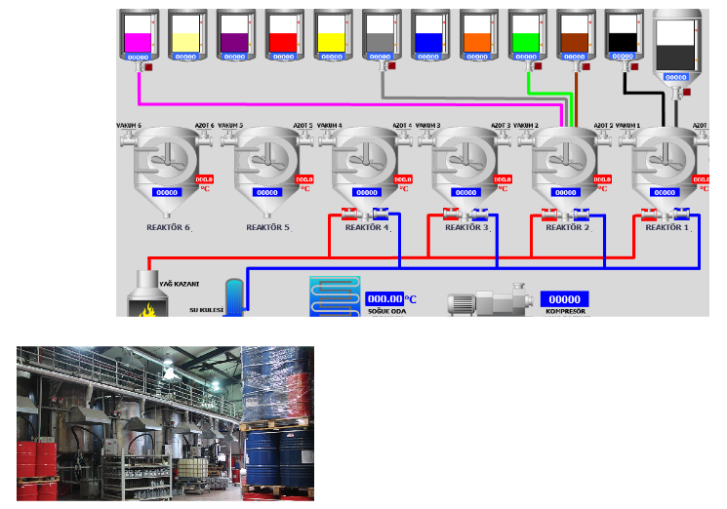
COMPANY OVERVIEW
In our factories during production
stages we use fully automatic dosing system
Industry 4.0 (Europe) and machine interaction and production management IIOT (USA) system.

Slide 5
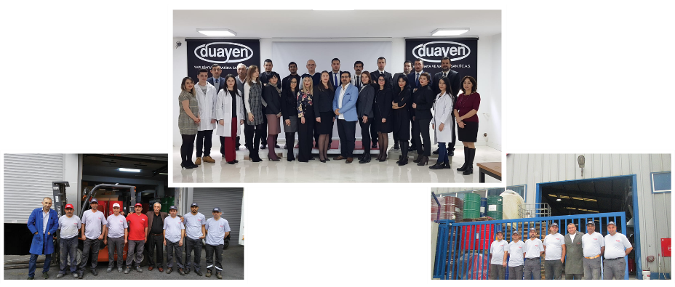
COMPANY OVERVIEW
- 30 out of 48 of our staff are highly qualified professionals.
- In our service portfolio there are 568 clients purchasing 150 different products.
- We have 12 domestic dealers / 10 international dealers / active sales to 60 countries.

Slide 6
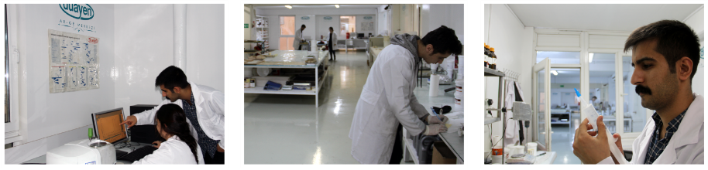

COMPANY OVERVIEW
R & D DEPARTMENT
4% of company’s turnover is used for R&D activities.
Product development activities are being continued
by around 8 expert R&D engineers.
In 2018 we were approved and registered within a limited number of recognized R&D Center in Turkey.

Slide 7


DUAYEN IN THE WORLD
WORLDWIDE DUAYEN DESTINATIONS

Slide 8
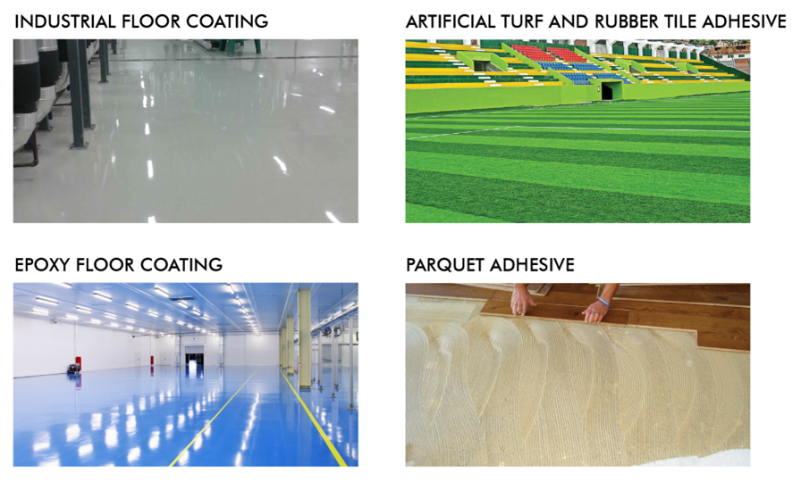
SECTORS OVERVIEW

Slide 9
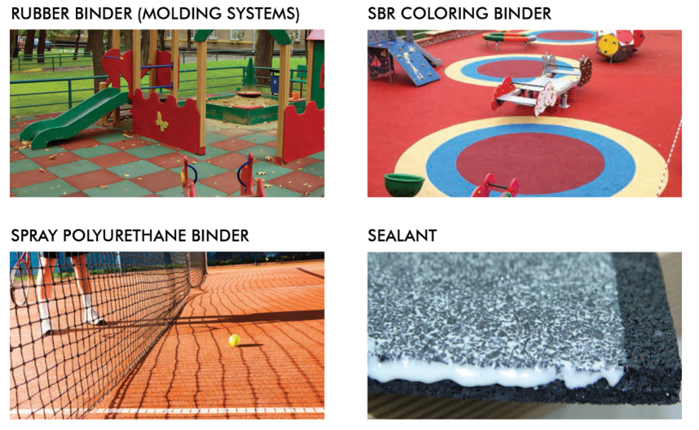
SECTORS OVERVIEW

Slide 10
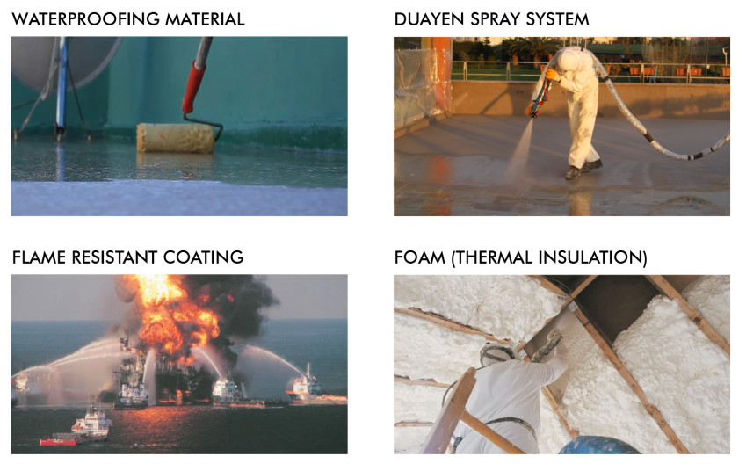
SECTORS OVERVIEW

Slide 11
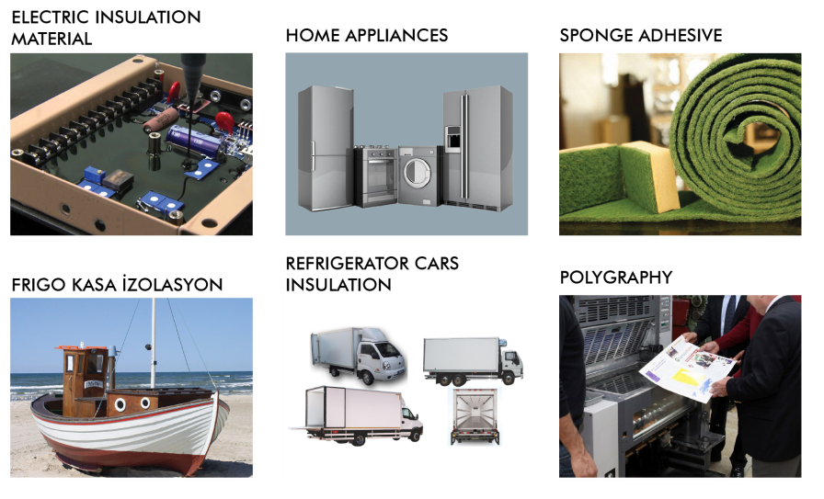
SECTORS OVERVIEW

Slide 12




APPLICATION VIDEOS

Slide 13
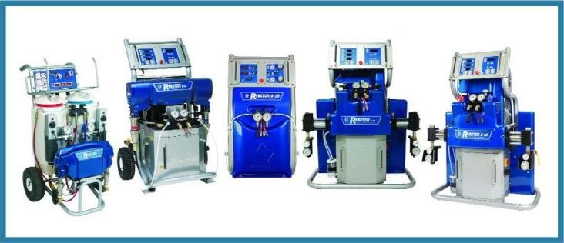
GRACO
Graco isolation long-lasting spraying machines have proven to be the world leader for
Poliurea and Polyurethane foam insulation applications providing the technical support
with the help of reactor, gun, heating hose, whip hose and other replacement parts.
www.graco-duayen.com

Slide 14

REFERENCES

Slide 15

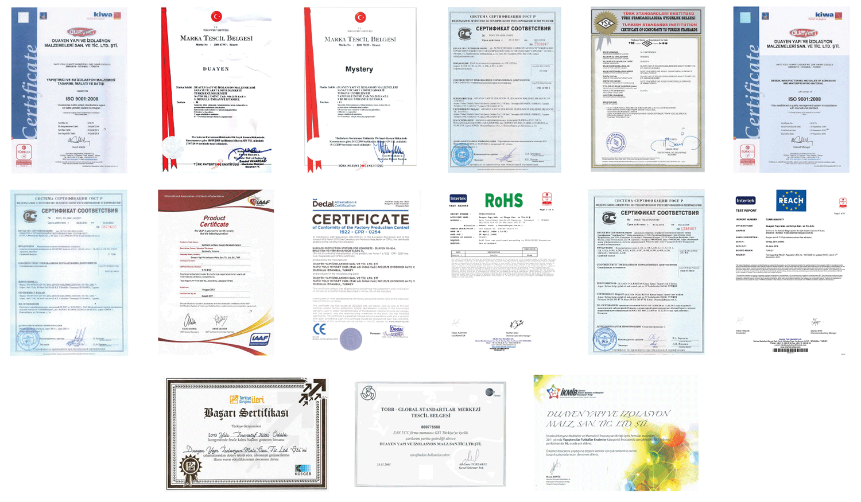
QUALITY & REWARD CERTIFICATES

Slide 16

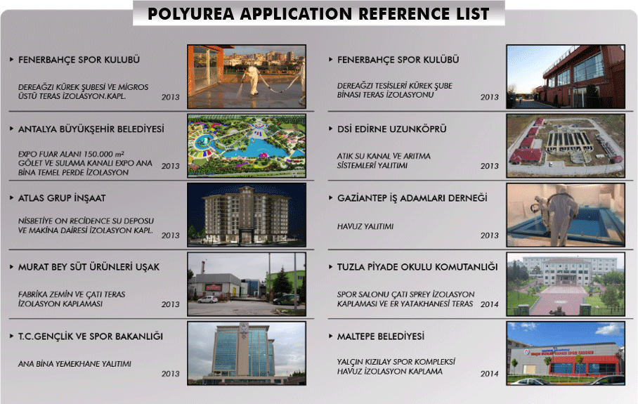

Slide 17
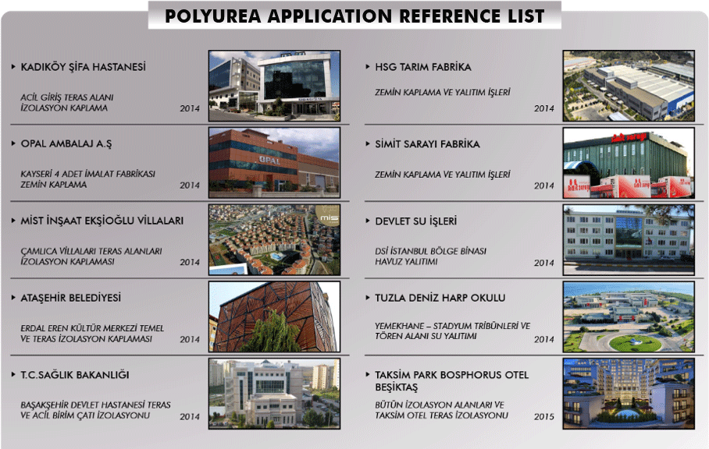

Slide 18
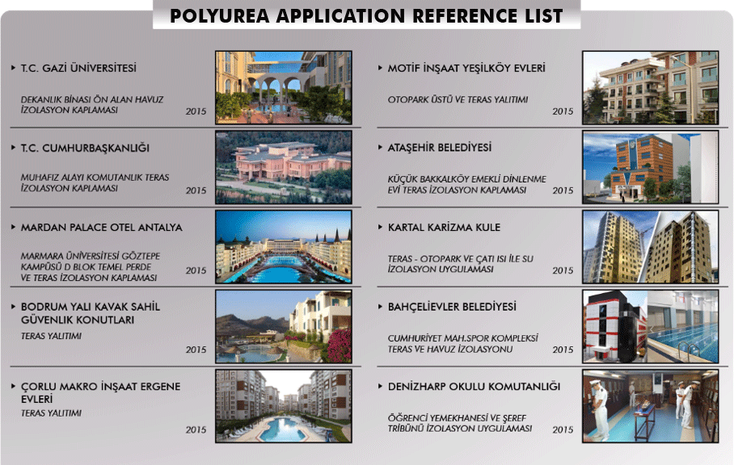

Slide 19
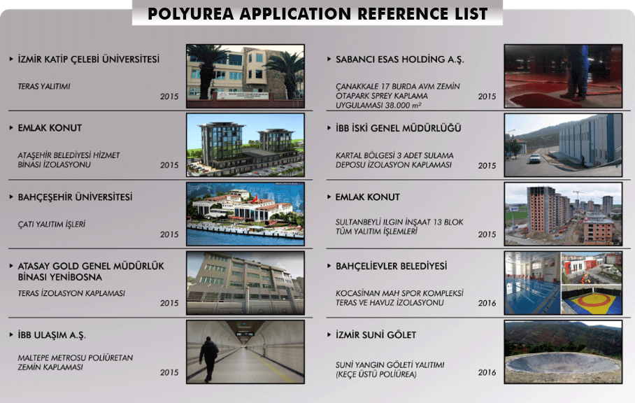

Slide 20
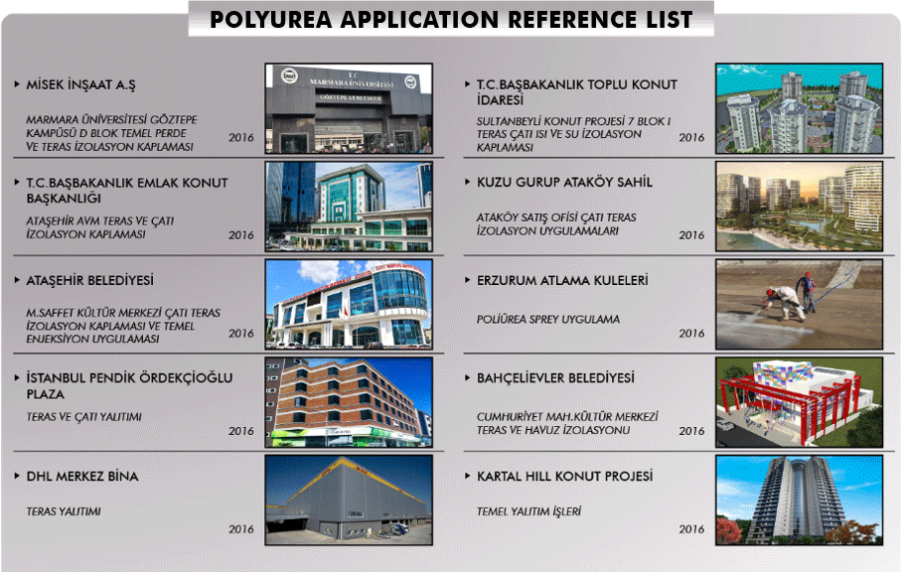

Slide 21
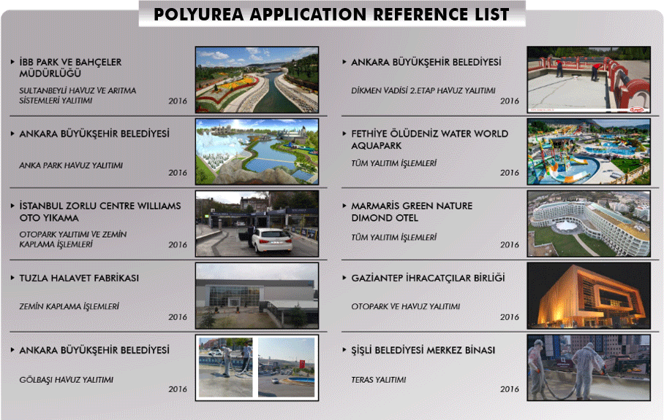

Slide 22
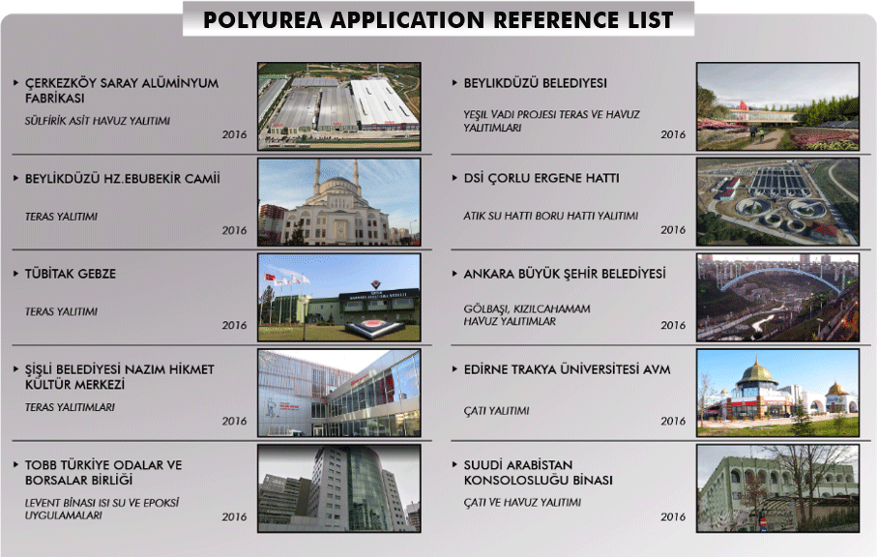

Slide 23
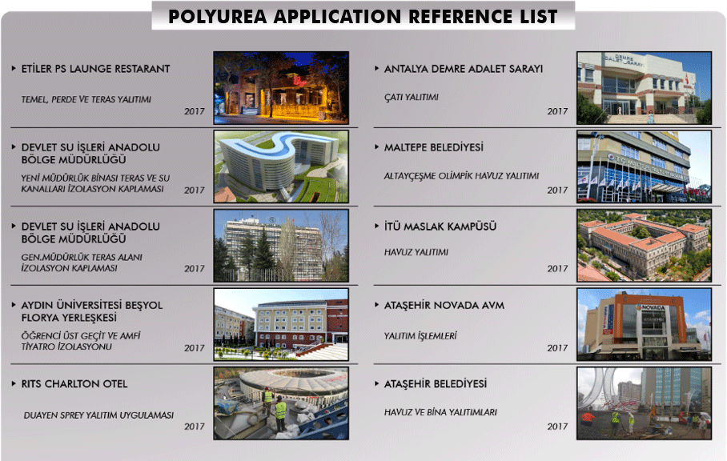

Slide 24

Thank you for your interest…

